Slide 1
Interworkings -computers for new hires
Josh howard

Slide 2
Standard components
CPU – i7-8700k ($347.00 )
Cooling – Noctua NH-D15 ($86.20)
Memory - CORSAIR Dominator Platinum 64GB ($799.99)
Motherboard – ASRock Z370 Killer ($134.99)
Powersupply – SuperNOVA 850 ($264.75)
Storage (OS) - SAMSUNG 960 PRO ($321.95)
Storage (Internal) - WD Black 6TB ($259.99)
Monitor – BenQ PD3200U ($799.00)

Slide 3
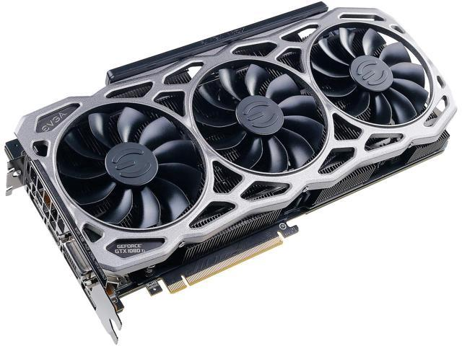
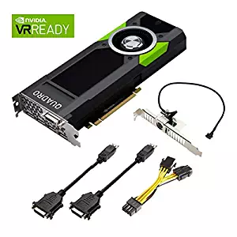
Gpu
EVGA GTX1080Ti – $1298.99
Nvidia Quadro P5000 – $1809.00

Slide 4
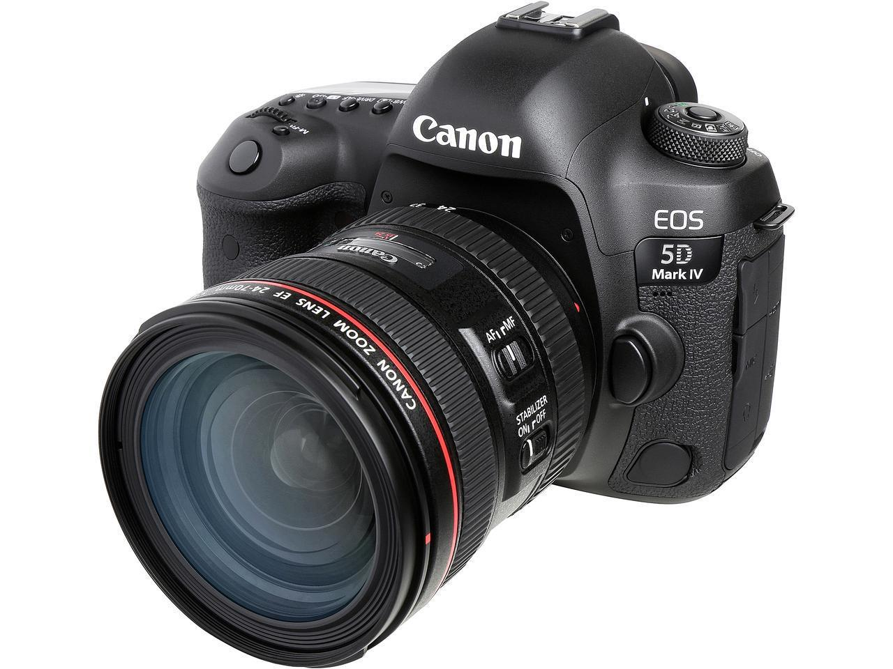
Camera
Canon EOS 5D Mark IV – ($3,799.00)

Slide 5
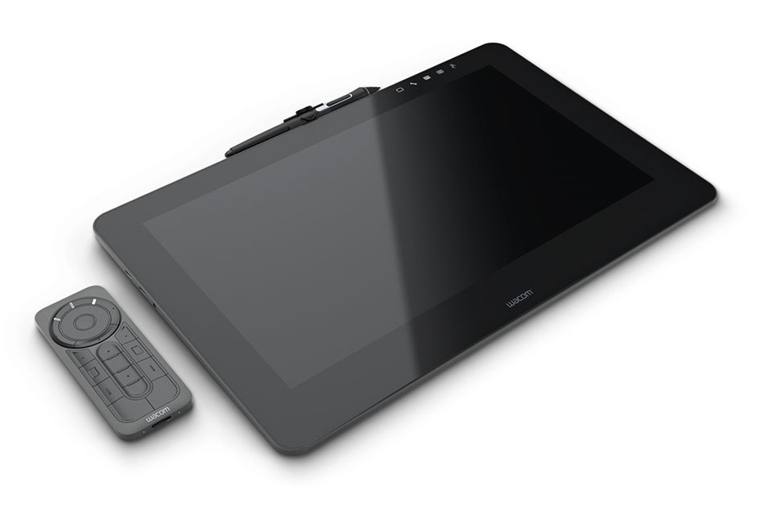
Drawing Tablet
Wacom Cintiq Pro 16 ($1,499.95)

Slide 6
MISC
External Storage - WD 4TB Elements Portable ($347.00)
Headphones – Sennheiser HD 280 PRO ($99.95)
Mouse – Logitech G300S ($24.99)
Keyboard – Logitech G810 ($119.99)
Optical Drive – LG Ultra-HD Blu-ray Drive ($99.99)
UPS System – CyberPower Intelligent 900 Watt ($144.95)
USB Hub – AmazonBasics 7 ($26.82)
Webcam – Logitech C920 ($59.99)

Slide 7
Software
Adobe Reader ($FREE)
AutoCad ($2,525.00/year)
Operating System ($149.99/once)
Adobe Creative Cloud ($79.99/month)

Slide 8
Cost
Initial Cost - $109,861.88
Yearly Cost - $3,484.88

